Slide 1
SOP and POS forms
Boolean expressions can be written in the sum-of-products form (SOP, 乘积项之和) or in the product-of-sums form (POS, 和项之乘积). These forms can simplify the implementation of combinational logic, particularly with PLDs. In both forms, an overbar cannot extend over more than one variable.
An expression is in SOP form when two or more product terms are summed as in the following examples:
A B C + A B A B C + C D C D + E
An expression is in POS form when two or more sum terms are multiplied as in the following examples:
(A + B)(A + C) (A + B + C)(B + D) (A + B)C

Slide 2
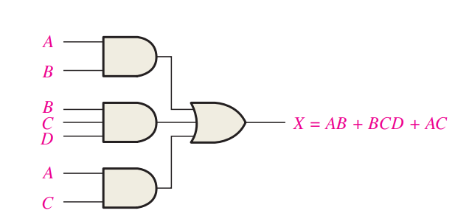
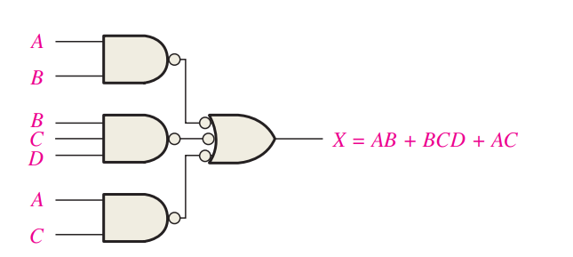
Implementation of SOP Expression
AND/OR implementation of an SOP expression
NAND/NAND implementation of an SOP expression

Slide 4
SOP Standard form
In SOP standard form (最小项), every variable in the domain must appear in each term. This form is useful for constructing truth tables or for implementing logic in PLDs.
You can expand a nonstandard term to standard form by multiplying the term by a term consisting of the sum of the missing variable and its complement.
Example
Convert X = A B + A B C to standard form.
Solution
The first term does not include the variable C. Therefore, multiply it by the (C + C), which = 1:
X = A B (C + C) + A B C
= A B C + A B C + A B C

Slide 6
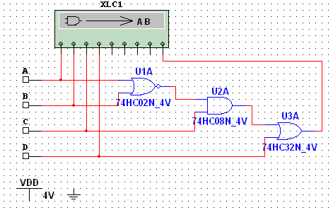
SOP Standard form
The Logic Converter in Multisim can convert a circuit into standard SOP form.
Example
Use Multisim to view the logic for the circuit in standard SOP form.
Solution
Click the truth table to logic button on the Logic Converter.
See next slide…

Slide 7
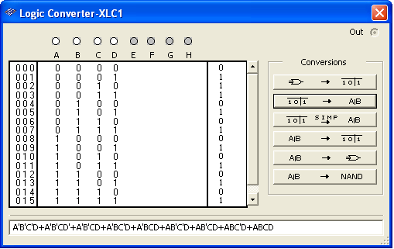
SOP Standard form
SOP Standard form

Slide 8
Binary representation of a standard product term
A standard product term is equal to 1 for only one combination of variable values.
Remember, a product term is implemented with an AND gate whose output is 1 only if each of its inputs is 1.
An SOP expression is equal to 1 only if one or more of the product terms in the expression is equal to 1.

Slide 10
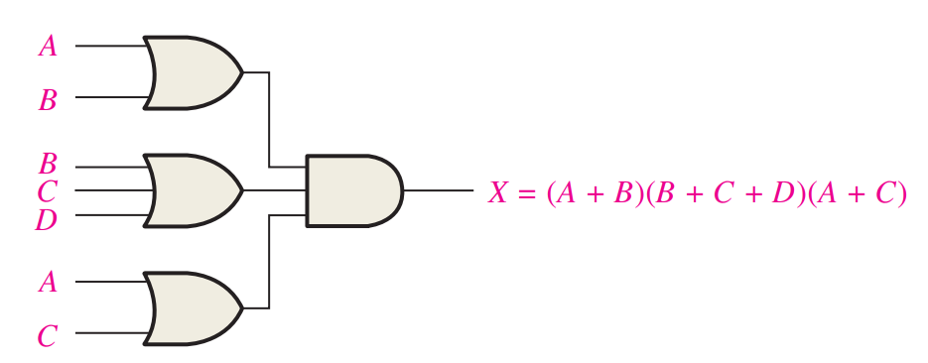
Implementation of POS Expression
OR/AND implementation of a POS expression
NOR/NOR implementation of a POS expression

Slide 11
POS Standard form
In POS standard form (最大项), every variable in the domain must appear in each sum term of the expression.
You can expand a nonstandard POS expression to standard form by adding the product of the missing variable and its complement and applying rule 12, which states that (A + B)(A + C) = A + BC.
Example
Convert X = (A + B)(A + B + C) to standard form.
Solution
The first sum term does not include the variable C. Therefore, add C C and expand the result by rule 12.
X = (A + B + C C)(A + B + C)
= (A +B + C )(A + B + C)(A + B + C)

Slide 13
Binary representation of a standard sum term
A standard sum term is equal to 0 for only one combination of variable values.
Remember, a sum term is implemented with an OR gate whose output is 0 only if each of its inputs is 0. Inverters are used to produce the complements of the variables as required.
A POS expression is equal to 0 only if one or more of the sum terms in the expression is equal to 0.

Slide 15
Converting SOP form to Truth Table
Steps:
1. List all possible combinations of binary values of the variables in the expression.
2. Convert the SOP form to its standard form.
3. Place a 1 in the output column for each binary value that make the standard SOP expression a 1 and place 0 for all the remaining binary values.

Slide 16
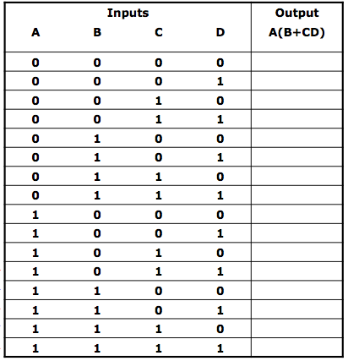
Converting SOP form to Truth Table
Example
X=A(B+CD)
Solution
Step1: List the combination of input variable values.

Slide 17
Step2: Convert to standard SOP form.
1111
1110
1101
1100
1011

Slide 18
Inputs |  |  |  | Output
A | B | C | D | A(B+CD)
0 | 0 | 0 | 0
0 | 0 | 0 | 1
0 | 0 | 1 | 0
0 | 0 | 1 | 1
0 | 1 | 0 | 0
0 | 1 | 0 | 1
0 | 1 | 1 | 0
0 | 1 | 1 | 1
1 | 0 | 0 | 0
1 | 0 | 0 | 1
1 | 0 | 1 | 0
1 | 0 | 1 | 1
1 | 1 | 0 | 0
1 | 1 | 0 | 1
1 | 1 | 1 | 0
1 | 1 | 1 | 1
Step3: Place 1s and 0s in truth table.
0
0
0
0
0
0
0
0
0
0
0
1
1
1
1
1

Slide 19
Converting POS form to Truth Table
Steps:
1. List all possible combinations of binary values of the variables in the expression.
2. Convert the POS form to its standard form.
3. Place a 0 in the output column for each binary value that make the standard POS expression a 0 and place 1 for all the remaining binary values.

Slide 20
Converting POS form to Truth Table
Example
Determine the truth table for following expression:
Solution
000
010
011
101
110
And the Truth Table on the next page…

Slide 21
Converting POS form to Truth Table
Example
Determine the truth table for following expression:
Solution
Input |  |  | Output
A | B | C | x
0 | 0 | 0 | 0
0 | 0 | 1 | 1
0 | 1 | 0 | 0
0 | 1 | 1 | 0
1 | 0 | 0 | 1
1 | 0 | 1 | 0
1 | 1 | 0 | 0
1 | 1 | 1 | 1

Slide 22
Converting Truth Table to SOP/POS standard form
Example
Solution
Determine the SOP/POS of x:
SOP std. form:
Input |  |  | Output
A | B | C | x
0 | 0 | 0 | 0
0 | 0 | 1 | 0
0 | 1 | 0 | 0
0 | 1 | 1 | 1
1 | 0 | 0 | 1
1 | 0 | 1 | 0
1 | 1 | 0 | 1
1 | 1 | 1 | 1
POS std. form:

Slide 23
Converting Truth Table to SOP/POS standard form
Example
Solution
Determine the SOP/POS of x:
SOP std. form:
Input |  |  | Output
A | B | C | x
0 | 0 | 0 | 0
0 | 0 | 1 | 1
0 | 1 | 0 | 0
0 | 1 | 1 | 0
1 | 0 | 0 | 1
1 | 0 | 1 | 0
1 | 1 | 0 | 0
1 | 1 | 1 | 1
POS std. form:

Slide 24
Logic Expressions and Truth Table
Example
Solution
Determine the Truth Table of X according to the std. SOP:
Input |  |  | Output
A | B | C
0 | 0 | 0
0 | 0 | 1
0 | 1 | 0
0 | 1 | 1
1 | 0 | 0
1 | 0 | 1
1 | 1 | 0
1 | 1 | 1
0
(1)
(2)
(3)
(2)
1
1
(3)
0
0
0
0
1
(1)

Slide 25
Logic Expressions and Truth Table
Example
Solution
Determine the Truth Table of X according to the std. SOP:
Input |  |  | Output
A | B | C
0 | 0 | 0
0 | 0 | 1
0 | 1 | 0
0 | 1 | 1
1 | 0 | 0
1 | 0 | 1
1 | 1 | 0
1 | 1 | 1
1
(2)
(1)
(2)
(3)
(4)
0
1
(3)
0
0
1
(1)
0
(4)
1

Slide 26
Logic Expressions and Truth Table
Example
Solution
Determine the Truth Table of X according to the SOP:
Input |  |  | Output
A | B | C
0 | 0 | 0
0 | 0 | 1
0 | 1 | 0
0 | 1 | 1
1 | 0 | 0
1 | 0 | 1
1 | 1 | 0
1 | 1 | 1
1
1
0
0
0
1
0
0

Slide 27
Logic Expressions and Truth Table
Example
Solution
Determine the Truth Table of X according to the std. POS:
Input |  |  | Output
A | B | C
0 | 0 | 0
0 | 0 | 1
0 | 1 | 0
0 | 1 | 1
1 | 0 | 0
1 | 0 | 1
1 | 1 | 0
1 | 1 | 1
0
(1)
(1)
(2)
1
1
1
1
0
(2)
1
1

Slide 28
Logic Expressions and Truth Table
Example
Solution
Determine the std. SOP of X according to the Truth Table:
+
+
+
Input |  |  | Output X
A | B | C
0 | 0 | 0
0 | 0 | 1
0 | 1 | 0
0 | 1 | 1
1 | 0 | 0
1 | 0 | 1
1 | 1 | 0
1 | 1 | 1
(1)
(2)
(3)
(4)
(1)
1
0
(2)
1
0
0
1
(3)
0
(4)
1

Slide 29
Logic Expressions and Truth Table
Example
Solution
Determine the std. POS of X according to the Truth Table:
(1)
Input |  |  | Output X
A | B | C
0 | 0 | 0
0 | 0 | 1
0 | 1 | 0
0 | 1 | 1
1 | 0 | 0
1 | 0 | 1
1 | 1 | 0
1 | 1 | 1
(2)
(3)
1
0
(1)
(4)
1
0
(2)
0
(3)
1
(4)
0
1

Slide 30
Karnaugh maps
The Karnaugh map (K-map) is a tool for simplifying combinational logic with 3 or 4 variables. For 3 variables, 8 cells are required (2³).
The map shown is for three variables labeled A, B, and C. Each cell represents one possible product term.
Each cell differs from an adjacent cell by only one variable.

Slide 31
Karnaugh maps
Cells are usually labeled using 0’s and 1’s to represent the variable and its complement.
The numbers are entered in gray code, to force adjacent cells to be different by only one variable.
Gray code
Ones are read as the true variable and zeros are read as the complemented variable.

Slide 32
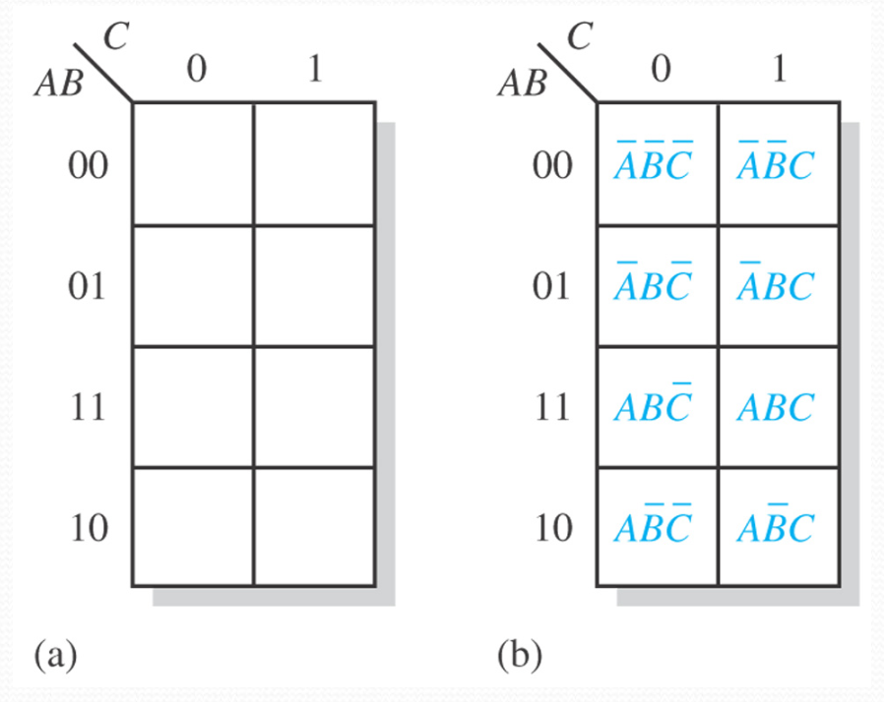
3-variable Karnaugh map

Slide 33
Karnaugh maps
Alternatively, cells can be labeled with the variable letters. This makes it simple to read, but it takes more time preparing the map.
C C
Example
Read the terms for the yellow cells.
AB
AB
AB
AB
Solution
The cells are ABC and ABC.

Slide 34
Karnaugh maps and the truth table
For any logic function F(A, B, C), its truth table is:
Input |  |  | Output F
A | B | C
0 | 0 | 0
0 | 0 | 1
0 | 1 | 0
0 | 1 | 1
1 | 0 | 0
1 | 0 | 1
1 | 1 | 0
1 | 1 | 1
Then it has a K-map:
F(0,0,0)
F(0,0,1)
F(0,1,0)
F(0,1,1)
F(1,0,0)
F(1,0,1)
F(1,1,0)
F(1,1,1)

Slide 35
Karnaugh maps and the truth table
For a logic function F(A, B, C) with truth table:
Input |  |  | Output F
A | B | C
0 | 0 | 0
0 | 0 | 1
0 | 1 | 0
0 | 1 | 1
1 | 0 | 0
1 | 0 | 1
1 | 1 | 0
1 | 1 | 1
Then it has a K-map:
1
1
1
0
1
0
1
1
0
1
0
1
1
1
1
1

Slide 36
Karnaugh maps
A 4-variable map has an adjacent cell on each of its four boundaries as shown.
Each cell is different only by one variable from an adjacent cell.
Grouping follows the rules given in the text.
The following slide shows an example of reading a four variable map using binary numbers for the variables…

Slide 37
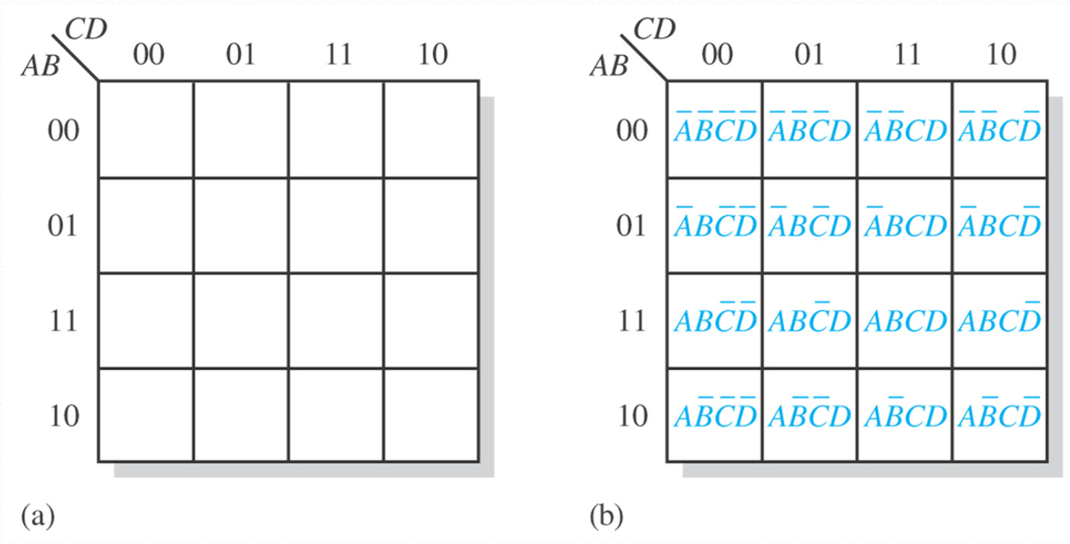
4-variable Karnaugh map

Slide 39
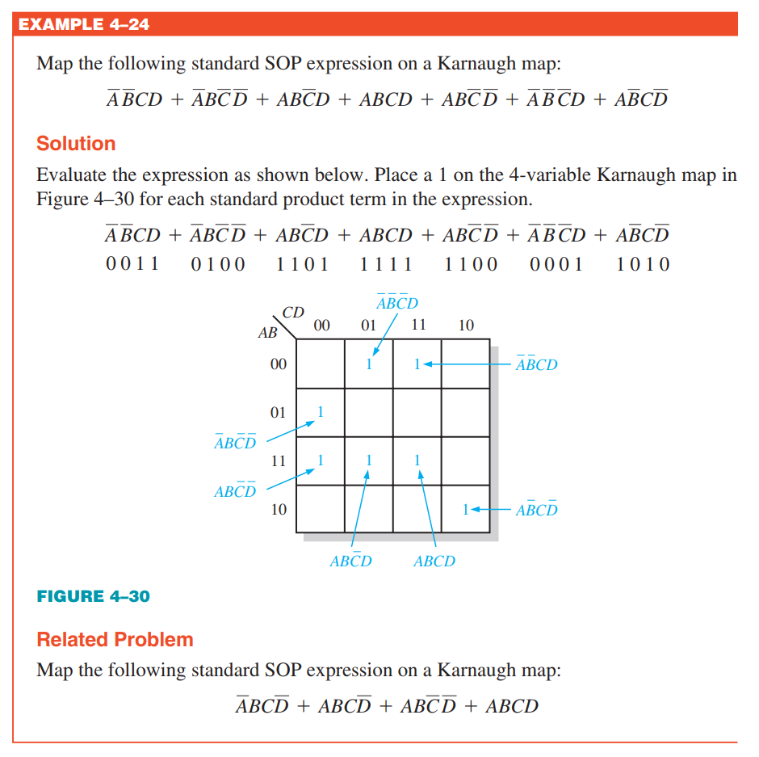

Slide 41
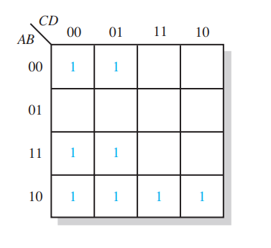

Slide 42
Karnaugh maps -- Group the 1s
Group the 1s
Maximize the size of the groups
Minimize the number of groups
Rules
A group must contain 2^{n} cells
Each cell must be adjacent to one or more cells in that group
Include 1s as much as possible
Each 1 on the map must be included at least one group
Cell with 1 can be included into more than one group

Slide 43
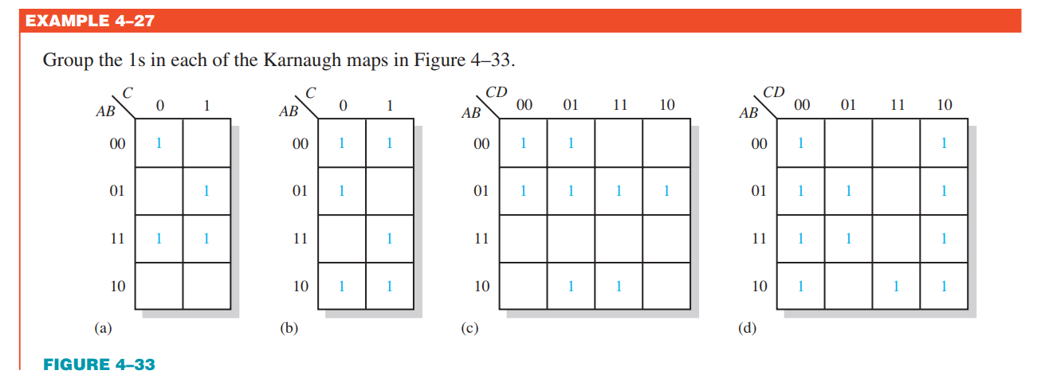
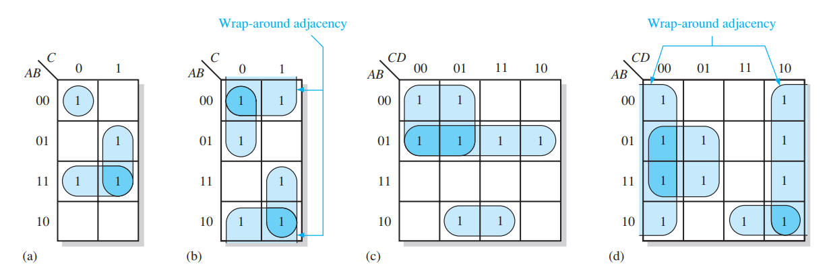

Slide 44
Karnaugh maps -- Determining the Minimum SOP Expression from the Map
1. Group the cells that have 1s. Each group of cells containing 1s creates one product term composed of all variables that occur in only one form (either uncomplemented or complemented) within the group. Variables that occur both uncomplemented and complemented within the group are eliminated. These are called contradictory variables.
2. Determine the minimum product term for each group.
For a 3-variable map:
(1) A 1-cell group yields a 3-variable product term
(2) A 2-cell group yields a 2-variable product term
(3) A 4-cell group yields a 1-variable term
(4) An 8-cell group yields a value of 1 for the expression
3. When all the minimum product terms are derived from the Karnaugh map, they are summed to form the minimum SOP expression.

Slide 46
Karnaugh maps
K-maps can simplify combinational logic by grouping cells and eliminating variables that change.
Example
Group the 1’s on the map and read the minimum logic.
Solution
1. Group the 1’s into two overlapping groups as indicated.
Read each group by eliminating any variable that changes across a boundary.
B changes across this boundary
The vertical group is read AC.
C changes across this boundary
The horizontal group is read AB.
X = AC +AB

Slide 47
Karnaugh maps
Example
Simplify the logic function with K-map:
Solution
1
0
+
+
1
1
0
1
1
1

Slide 48
Karnaugh maps
Example
Simplify the logic function with K-map:
Solution
1
0
+
+
1
1
0
1
1
1

Slide 49
Karnaugh maps
Example
Group the 1’s on the map and read the minimum logic.
C changes across outer boundary
Solution
1. Group the 1’s into two separate groups as indicated.
Read each group by eliminating any variable that changes across a boundary.
B changes
B changes
The upper (yellow) group is read as AD.
The lower (green) group is read as AD.
C changes
X
X = AD +AD

Slide 51
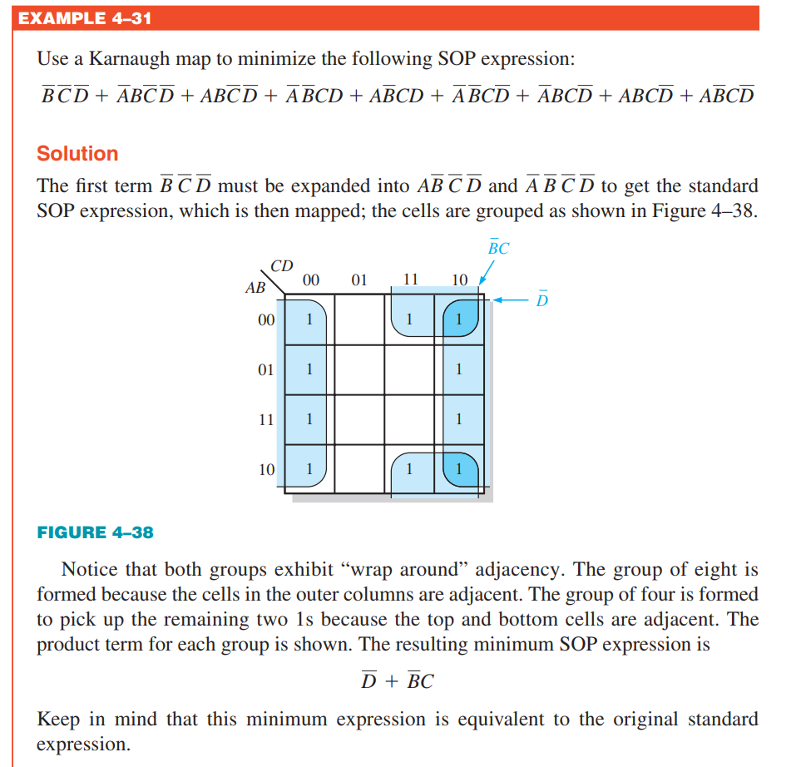

Slide 52
Simplifying functions with don’t care terms
Don’t Care Terms
Some input combinations may never appear
For example, BCD input never produce “1100”
How to handle Don’t Care Terms
May be treated as 1, or 0
Often decisions are tend to result in simpler logic

Slide 53
Simplifying functions with don’t care terms
Input |  |  |  | Output Y
A | B | C | D
0 | 0 | 0 | 0 | 0
0 | 0 | 0 | 1 | 0
0 | 0 | 1 | 0 | 0
0 | 0 | 1 | 1 | 0
0 | 1 | 0 | 0 | 0
0 | 1 | 0 | 1 | 0
0 | 1 | 1 | 0 | 0
0 | 1 | 1 | 1 | 1
1 | 0 | 0 | 0 | 1
1 | 0 | 0 | 1 | 1
1 | 0 | 1 | 0 | X
… |  |  |  | …
1 | 1 | 1 | 1 | X
Treating the ‘X’s as ‘0’s
+

Slide 54
Simplifying functions with don’t care terms
Input |  |  |  | Output Y
A | B | C | D
0 | 0 | 0 | 0 | 0
0 | 0 | 0 | 1 | 0
0 | 0 | 1 | 0 | 0
0 | 0 | 1 | 1 | 0
0 | 1 | 0 | 0 | 0
0 | 1 | 0 | 1 | 0
0 | 1 | 1 | 0 | 0
0 | 1 | 1 | 1 | 1
1 | 0 | 0 | 0 | 1
1 | 0 | 0 | 1 | 1
1 | 0 | 1 | 0 | X
… |  |  |  | …
1 | 1 | 1 | 1 | X
Treating the ‘X’ as ‘1’s
+

Slide 56
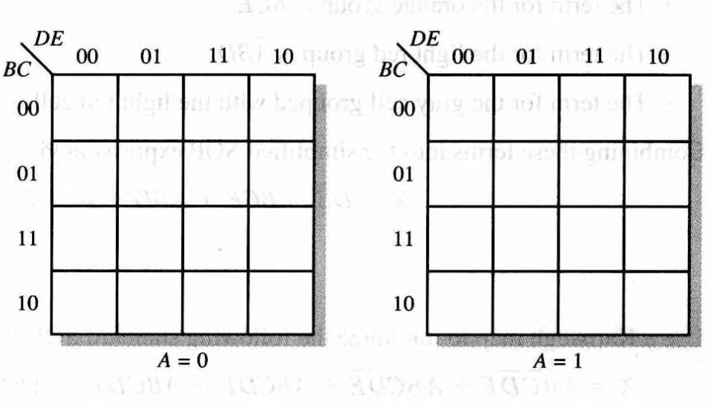
5-variable Karnaugh map

Slide 57
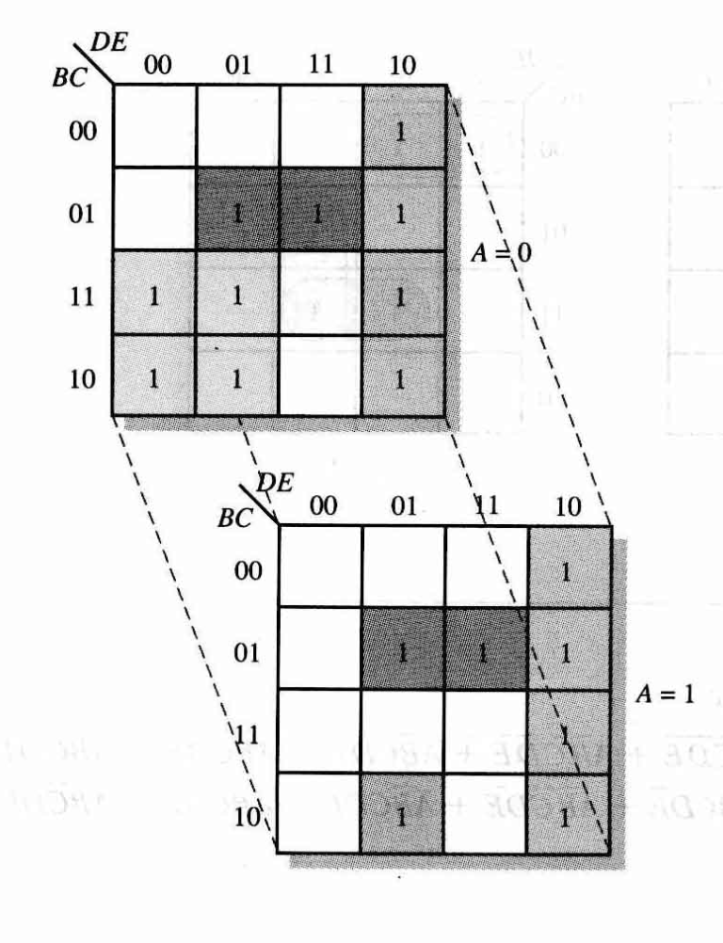

Slide 58
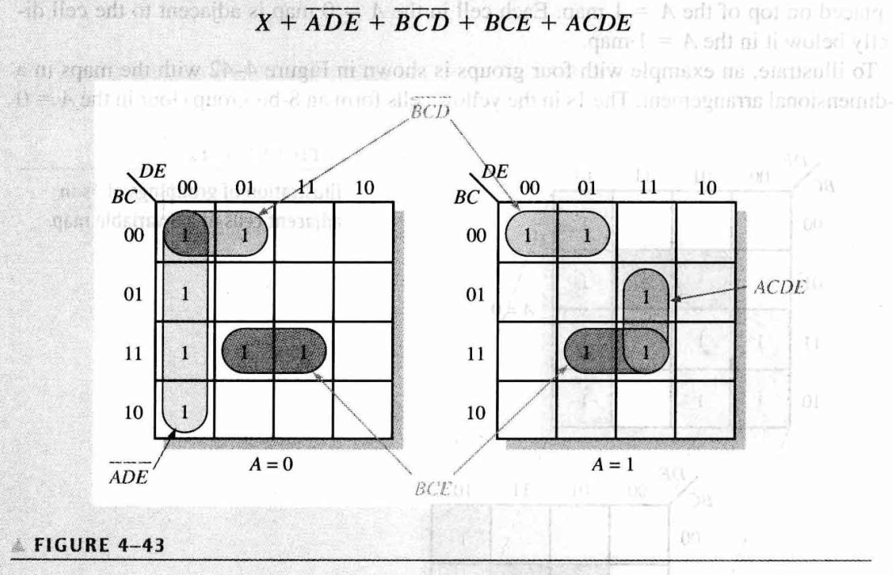

Slide 59
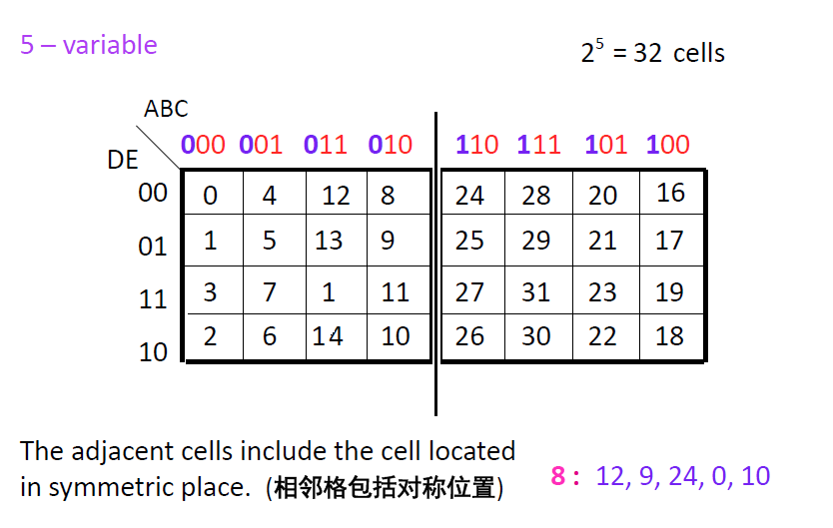

Slide 60
CDE
 | 000 | 001 | 011 | 010 | 110 | 111 | 101 | 100
00 | 1 | 1 |  |  |  |  |  | 1
01 | 1 |  |  |  |  | 1 | 1 | 1
11 |  |  |  |  |  | 1 | 1
10 | 1 | 1 |  |  |  | 1
AB
$$Y=BCE+\overline{A}\overline{D}\overline{E}+\overline{B}\overline{C}\overline{D}+ACDE$$

Slide 61
Quiz
1. The associative law for addition is normally written as
a. A + B = B + A
b. (A + B) + C = A + (B + C)
c. AB = BA
d. A + AB = A
© 2008 Pearson Education

Slide 62
Quiz
3. The Boolean expression A . 1 is equal to
a. A
b. B
c. 0
d. 1
© 2008 Pearson Education

Slide 63
Quiz
4. The Boolean expression A + 1 is equal to
a. A
b. B
c. 0
d. 1
© 2008 Pearson Education

Slide 64
Quiz
5. The Boolean equation AB + AC = A(B+ C) illustrates
a. the distribution law
b. the commutative law
c. the associative law
d. DeMorgan’s theorem
© 2008 Pearson Education

Slide 65
Quiz
6. A Boolean expression that is in standard SOP form is
a. the minimum logic expression
b. contains only one product term
c. has every variable in the domain in every term
d. none of the above
© 2008 Pearson Education

Slide 66
Quiz
7. Adjacent cells on a Karnaugh map differ from each other by
a. one variable
b. two variables
c. three variables
d. answer depends on the size of the map
© 2008 Pearson Education

Slide 67
Quiz
8. The minimum expression that can be read from the Karnaugh map shown is
a. X = A
b. X = A
c. X = B
d. X = B
© 2008 Pearson Education

Slide 68
Quiz
9. The minimum expression that can be read from the Karnaugh map shown is
a. X = A
b. X = A
c. X = B
d. X = B
© 2008 Pearson Education

